Slide 1


Green Pace
Security Policy Presentation
Developer: Ernest Enriquez

Slide 2

OVERVIEW: DEFENSE IN DEPTH
The security policy is designed to provide an end-to-end solution of systems that will implement a robust system of checks through many layers.

Slide 3
THREATS MATRIX
Likely 1,2,3,5,6,9,10 | Priority 2,3,4,5,8,9
Low priority 1,6,7,10 | Unlikely 4,7,8

Slide 4
10 PRINCIPLES
Validate input data
Heed Compiler Warnings
Architect and Design for Security Policies
Default Deny
Keep it Simple
Adhere to principle of least privilege
Sanitize data
Practice defense in depth
Effective Quality Assurance
Adopt secure coding standard

Slide 5
CODING STANDARDS
EXP59-CPP - Using data type offset() on valid types and members of the code
MSC52-CPP – Predicate function objects that are not mutable.
STR30-C – Avoid attempting to modify string literals.
MEM52-CPP – Address allocation failures.
DCL03-C – Accept assertions on the value of constant expressions.
ERR50-CPP – Avoid programs from termination.
STR02- C – Sanitize our data from input.
MEM30-C – Designed to protect memory.
CTR52-CPP – Guarantee that library functions do not overflow.
STR31-C – Ensure storage has space for character data.

Slide 6
ENCRYPTION POLICIES
Encryption in rest
Data-at-rest encryption is a method of protecting the local storage of data through encryption. The purpose of data-at-rest encryption is to protect application data from attackers who have access to the storage device but not the application itself, making the data physically unreadable. This policy applies because every state must protect data in order to have a truly in-depth protection strategy
Encryption at flight
Encryption at flight is essentially just encryption in transit. As the data is being transmitted, the data should be sent through encrypted channels. One example would be using HTTPS. This policy applies because where we already have our data encrypted in rest, why would we decrypt the data to transmit it, opening ourselves up to attack and breaking down our defense in depth strategy? We shouldn`t, which is why we need encryption at flight
Encryption in use
As before, this policy is enforced because exposing one of the defense-in-depth components could potentially make the entire system vulnerable. This is one of the most important things in my opinion as it can be a user-centric application and if the data is not stored properly, it can potentially pass unencrypted data to a non-malicious user. Encrypting data until needed is a fantastic idea and a policy we should support.

Slide 7
TRIPLE-A POLICIES
Authentication
The Authentication section of Triple-A is concerned with identifying users. This will usually be done through a User Login, which we are all aware with because we use them on a daily basis. To gain access to the network, each user must use a different set of credentials. The submitted credentials are compared to those stored in the database. This policy applies because user authentication is a critical first line of defense in protecting your network from intruders.
Authorization
After a user has been authenticated, they must receive Authorization in order to conduct network actions. Their level of system access is determined by the permission level assigned to their user account. Consumer users may be able to explore the network, manage their own accounts, and access files that they have permission to, but an administrator user may be able to make database changes, add new users to the system, and alter rights for current users. Because we need to conduct defense-in-depth, once a user has gained access, we should only provide them the permissions they need to execute the tasks that their user account requires, and only elevate permissions when absolutely necessary. Multiple secure coding concepts back this up.
Accounting
Accounting is the final step. This keeps track of how much bandwidth each user uses when connected to the network. This can be broken down into other categories, such as the length of time spent on the system, the data delivered and received, and the network files they accessed. This is a fantastic last line of defense to help secure our network. Even if an attacker manages to get beyond all of our other security procedures, we'll now be able to see what they're up to on our network. It's a last resort, but it's also required if we want to design the most secure system possible.

Slide 8
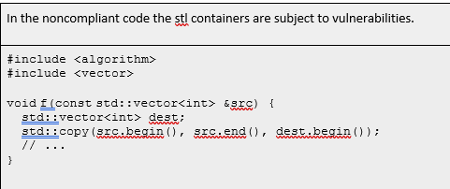
Unit Testing
In the noncompliant code the stl containers are subject to vulnerabilities.The standard that I chose CTR52-CPP ensures that the library function do not overflow.

Slide 9
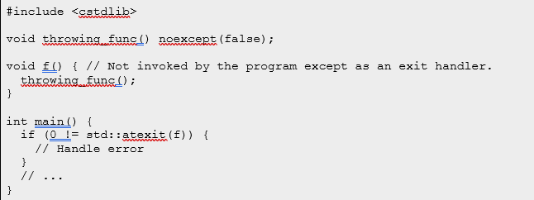
Unit Testing
In the non-compliant code, the call to function f could result in a call to std::terminate() because throwing_function() can result in an exception being thrown. Coding Standard ER50-CPP avoids programs from terminating due to errors.

Slide 10

AUTOMATION SUMMARY

Slide 11
TOOLS
The Green Pace DevOps process can be automated for enforcement during the Transition and Health check phases of the cycle. This is the stage of the process in which newly verified and tested settings are deployed. The deployment of these security settings can be automated by pushing updates to all live systems that include a set of pre-configured rules and standards. This will reduce the possibility of human error when configuring these rules and standards manually. Normally, penetration testing is done manually; however, a penetration testing lab could be automated to test newly released settings on a continuous basis. If this automated system gains unauthorized access to the new code, an event will be triggered immediately. Finally, the system would begin by closing all necessary ports and blocking IP addresses.

Slide 12
RISKS AND BENEFITS
Risks
Too much implemented security could slow down development when working with strict deadlines
Security need to be thought about early or the design may make it difficult to implement later
Benefits
More secure product for the customer
Knowing that you provided the most secure implementation of the software possible t o reduce the effects of an attack

Slide 13
RECOMMENDATIONS
Adapt to policy changes
Change Scope of Project
Additional Unit Testing

Slide 14
CONCLUSIONS
Data Sanitation processes to ensure secure input.
Develop and Implement encryption policies.
Vulnerability detection
Practice 10 principles of secure coding.

Slide 15
REFERENCES

